Slide 1
Shiny development
in an academic vs. business setting
Praer (Suthira Owlarn)
github.com/DusRUG

Slide 2
Hello shiny!

Slide 4


Organisations
~5 months
Tech company
NASDAQ-listed
~1,300 employees
~9 years
Research institute
Non-profit
~300 employees

Slide 5

Organisational mindset
Emphasis on impact/pragmatism
Utility is key (iterative shipments)
Logging (shinyEventLogger + bupaR)
Work in teams
Readable code (style guide, maybe use something like styler/lintr)
Emphasis on novelty/publications
Reproducibility is key*
DRY reproducible reports (shinymeta)
Work alone
Can use exotic packages
* Probably even truer in research related sectors

Slide 6
Organisational mindset: code quality
Code quality is a departmental priority
Surrounded by developers
Few incentives for maintainable software
Starting to change
Testing:
testthat (unit tests)
shinytest/RSelenium (integration tests)
golem (apps as packages)
Performance:
being aware of scoping rules
profvis (profile)
microbenchmark (benchmark)
caching

Slide 7
Task complexity
Dedicated data software and teams
Dedicated teams for making tools
shiny used to fill gaps: often relatively simple (complexity outside of app)

Slide 8
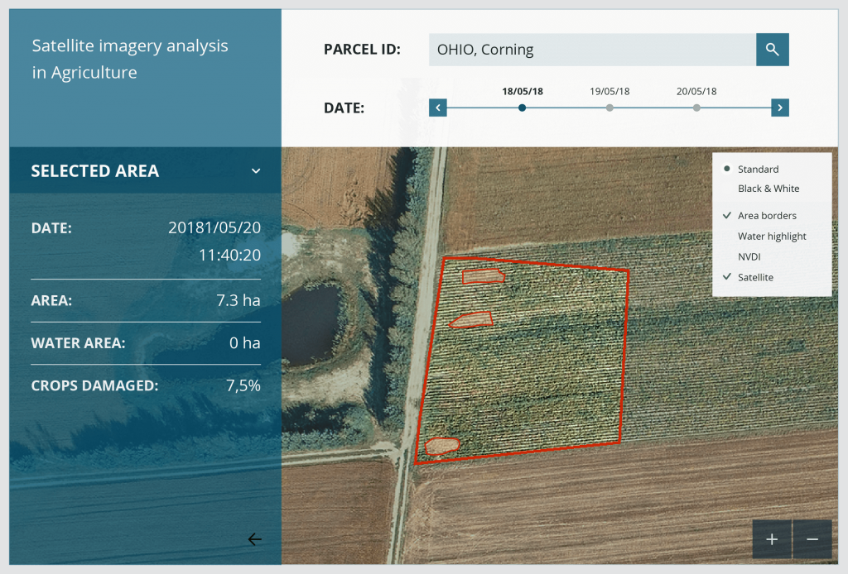
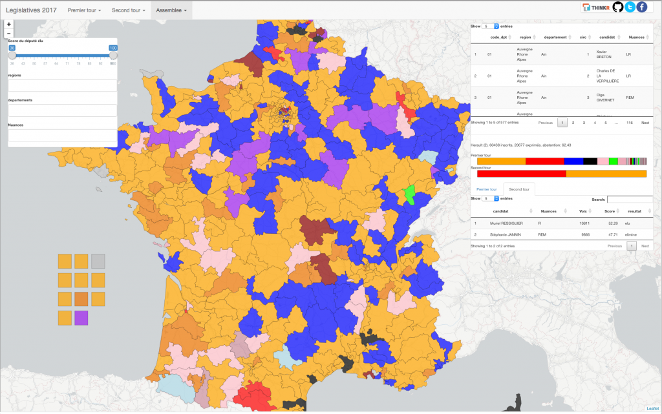
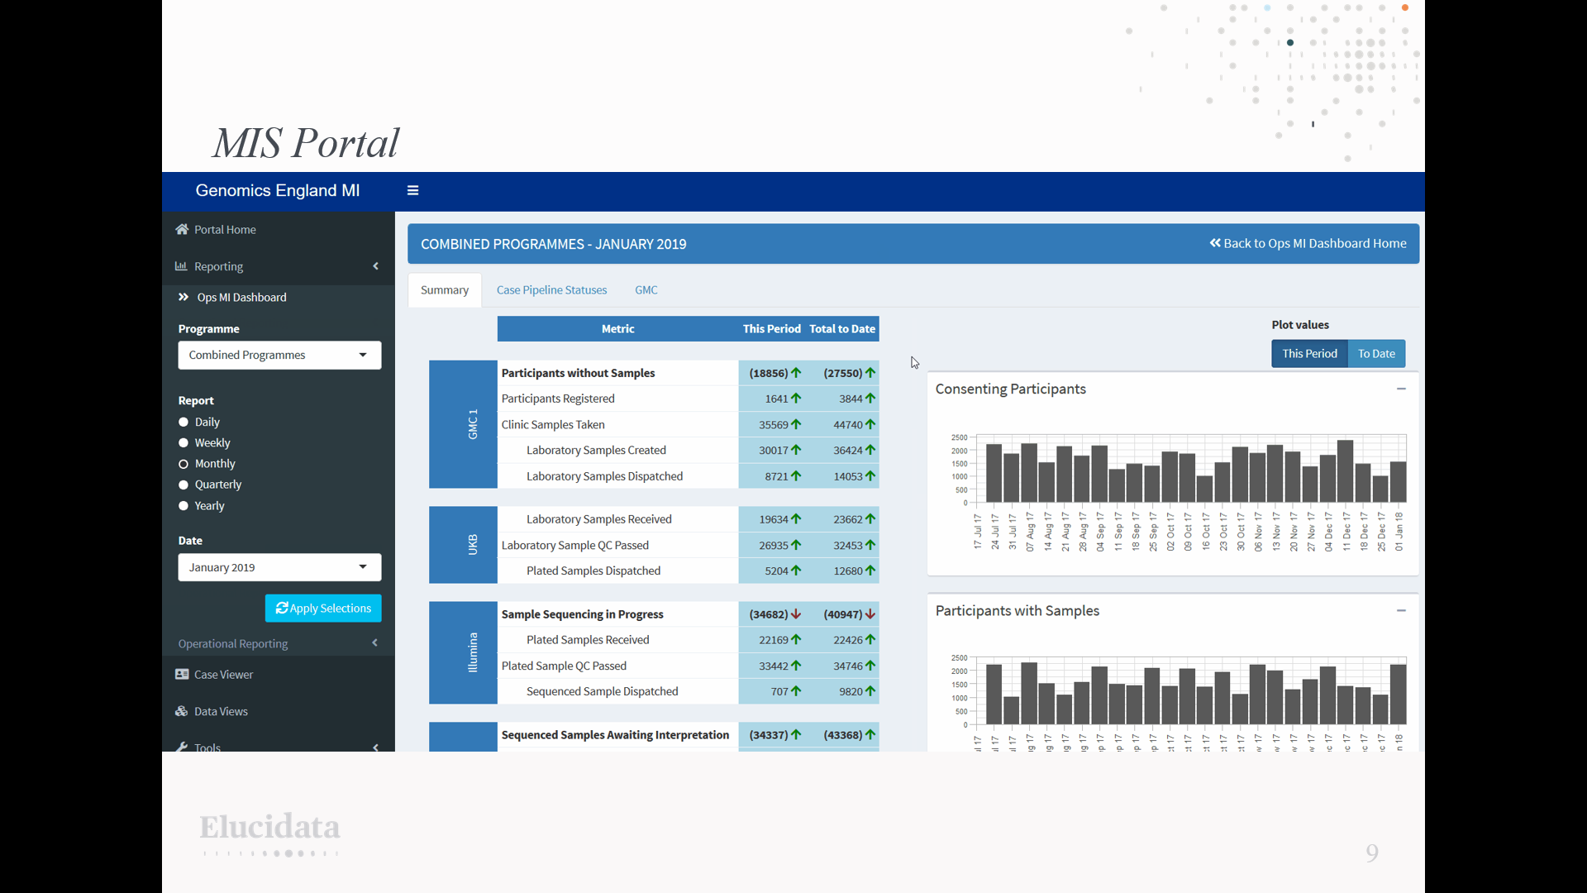
Task complexity
appsilon
ThinkR
Elucidata
Note: there are also consultancies who make extremely complicated shiny apps

Slide 9
Task complexity
Dedicated data software and teams
Dedicated teams for making tools
shiny used to fill gaps: often relatively simple (complexity outside of app)
Some specialised software
Some specialists for using tools
shiny rarely used: range from simple to very complex
Note: there are also consultancies who make extremely complicated shiny apps

Slide 10
Task complexity
reactivity: reactlog
modules
UI: shinyBS/bsplus (extra bootstrap components)
UX: shinyjs
easily change the state/style of an element
print messages to JS console

Slide 11
IT infrastructure
Very supportive
Fast response time
Extensive company-wide infrastructure
Community of shiny developers & users
Seem to be under pressure
Response time not always predictable
Tend to be conservative
Few top-down requirements/preferences
Shiny???
Version control
Local, staging and production environments
Number of stakeholders

Slide 12
IT infrastructure: deployment
desktop apps: photon (shiny + electron)
scheduled reports: crosstalk (interactivity in static HTML files)
performance:
shinyloadtest (realistic synthetic traffic)
plumber (REST API)
Shiny in production book
Caveat: this is an area I have no experience in!!

Slide 13
Your turn! :)
what’s obvious to you might not be to me!!
it doesn’t have to be 100% polished
I’d love to hear more about how you use R:
time series/spatial/graph analysis
efficient programming
statistics/machine learning/etc for dummies
making generative art
new packages you found/wrote
managing/supporting R users
… anything you’d like to share! :)

